Slide 1

6th Grade Accelerated Math
Unit 5, Lesson 5 Connecting Ratios and Rates Volume 1, pg. 193

Slide 2


Benchmark
MA.6.AR.3.3
Extend previous understanding of fractions and numerical patterns to generate or complete a two- or three-column table to display equivalent part-to-part ratios and part-to-part-to-whole ratios.
volume 1, pg. 193

Slide 3
Integrated Mathematical Thinking and Reasoning Standards
MA.K12.MTR.2.1 Demonstrate understanding by representing problems in multiple ways.
MA.K12.MTR.4.1 Engage in discussions that reflect on the mathematical thinking of self and others.
volume 1, pg. 193

Slide 4

Learning Target
I can make connections between ratios, rates, and unit rates.
volume 1, pg. 193

Slide 5

Warm-Up
volume 1, pg. 193

Slide 6

5.5.1 Warm-Up: Why Do Honeybees Love Hexagons?
Honeybees are actually amazing mathematicians. Scientists claim they can even calculate angles. They also live inside one of the most mathematically efficient architectural designs there is: the beehive. It takes a lot of work for bees to produce wax. The hexagonal shape of the cells in a honeycomb allows bees to store the most amount of honey while using the least amount of wax. This design likely evolved over time.
volume 1, pg. 193

Slide 7

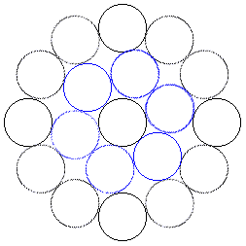
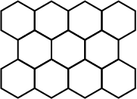
Consider the shapes used in the designs shown.
Triangular Cells | Circular Cells | Hexagonal Cells
How do the designs demonstrate that the hexagonal shape allows bees to store the most amount of honey using the least amount of wax?
This is an example of mathematics in nature. What is another example of mathematics in nature you can think of?
volume 1, pg. 193

Slide 8

Guided Instruction
volume 1, pg. 194

Slide 9
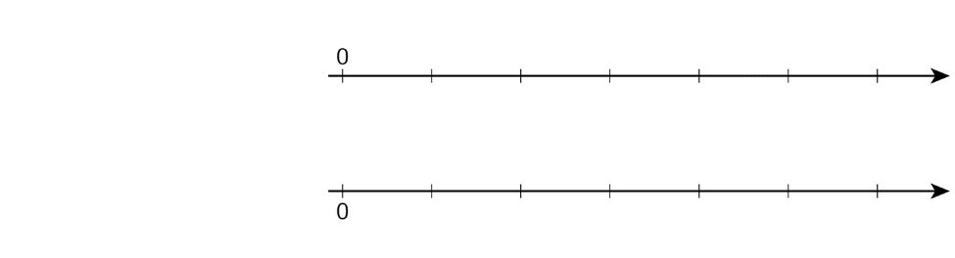
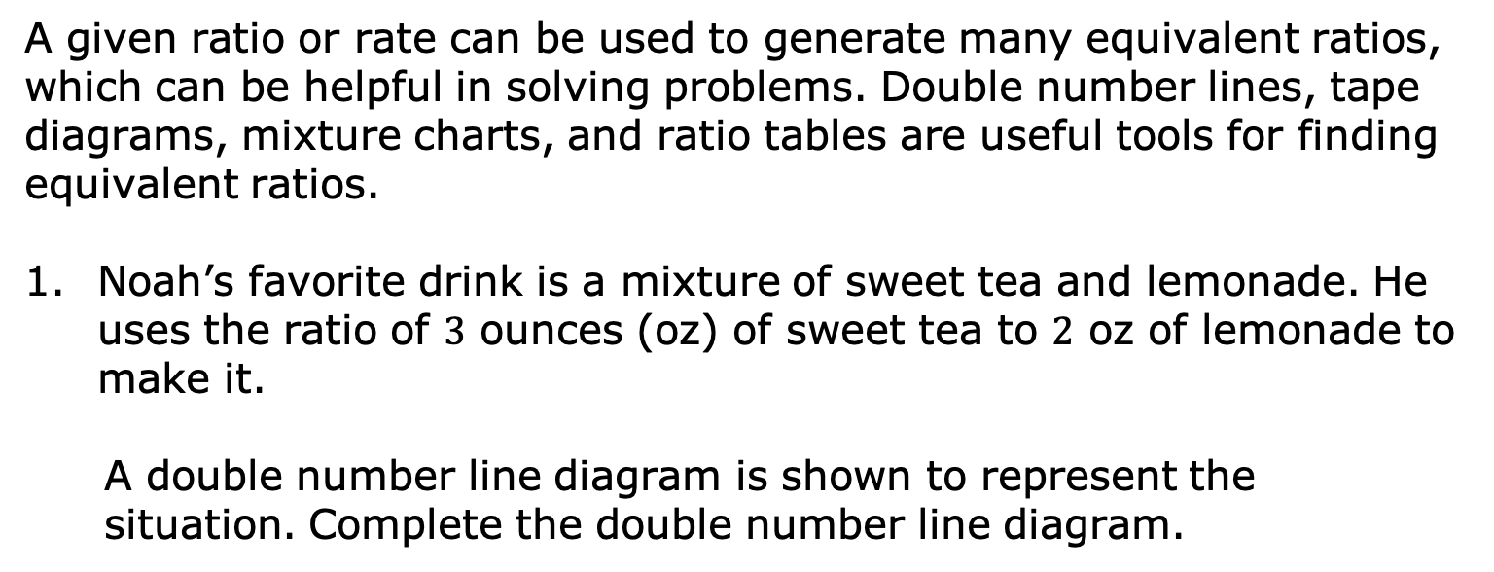




5.5.2 Guided Instruction: Connecting Ratios and Rates
A given ratio or rate can be used to generate many equivalent ratios, which can be helpful in solving problems. Double number lines, tape diagrams, mixture charts, and ratio tables are useful tools for finding equivalent ratios.
Noah’s favorite drink is a mixture of sweet tea and lemonade. He uses the ratio of $3$ ounces (oz) of sweet tea to $2$ oz of lemonade to make it.
A double number line diagram is shown to represent the situation. Complete the double number line diagram.
sweet tea
(oz)
$$0$$
$$3$$
lemonade (oz)
$$0$$
$$2$$
volume 1, pg. 194

Slide 10
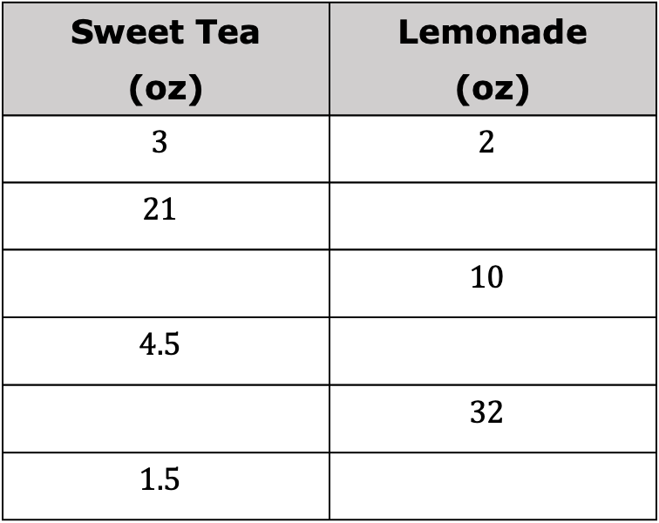
A table can also be used to represent this relationship.
Complete the table to show how many ounces of each beverage are needed to make different-sized batches of Noah’s favorite drink.
Sweet Tea (oz) | Lemonade (oz)
$$3$$ | $$2$$
$$21$$
 | $$10$$
$$4.5$$
 | $$32$$
$$1.5$$
volume 1, pg. 194

Slide 11
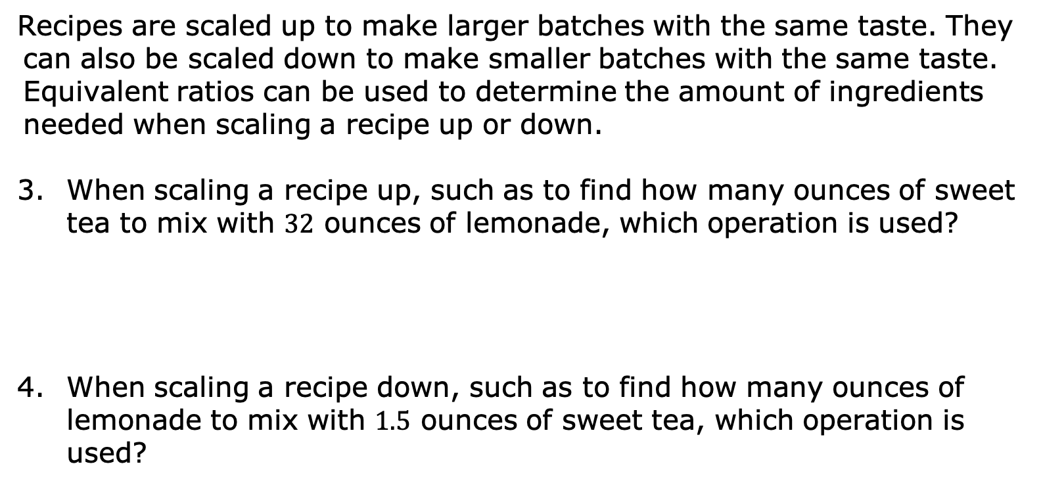
Recipes are scaled up to make larger batches with the same taste. They can also be scaled down to make smaller batches with the same taste. Equivalent ratios can be used to determine the amount of ingredients needed when scaling a recipe up or down.
When scaling a recipe up, such as to find how many ounces of sweet tea to mix with $32$ ounces of lemonade, which operation is used?
When scaling a recipe down, such as to find how many ounces of lemonade to mix with $1.5$ ounces of sweet tea, which operation is used?
volume 1, pg. 194

Slide 12
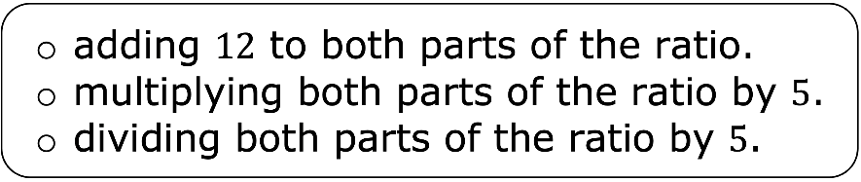
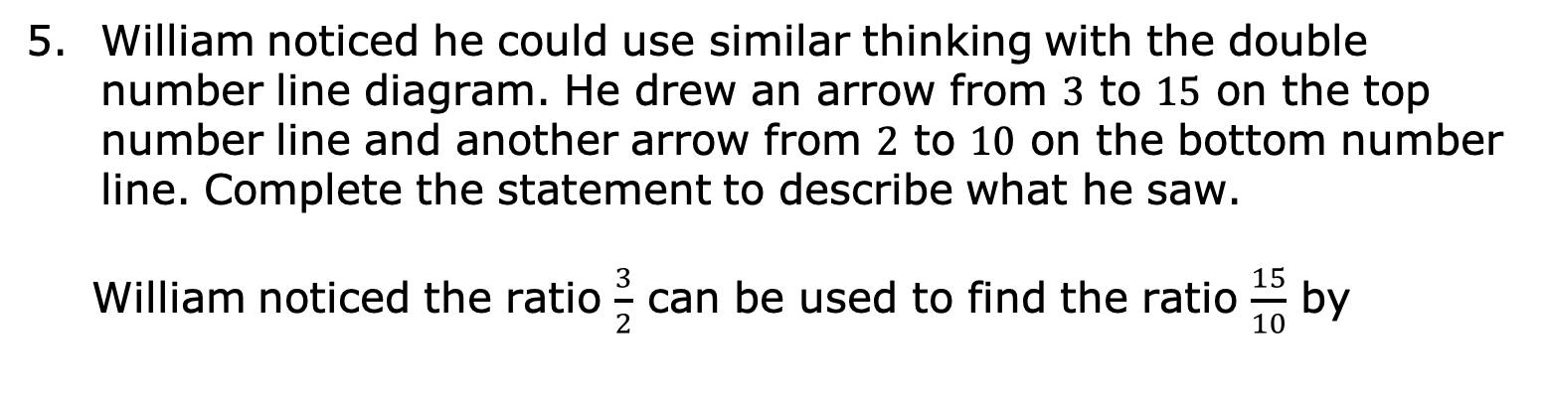
William noticed he could use similar thinking with the double number line diagram. He drew an arrow from $3$ to $15$ on the top number line and another arrow from $2$ to $10$ on the bottom number line. Complete the statement to describe what he saw.
William noticed the ratio $\frac{3}{2}$ can be used to find the ratio $\frac{15}{10}$ by
volume 1, pg. 194

Slide 13
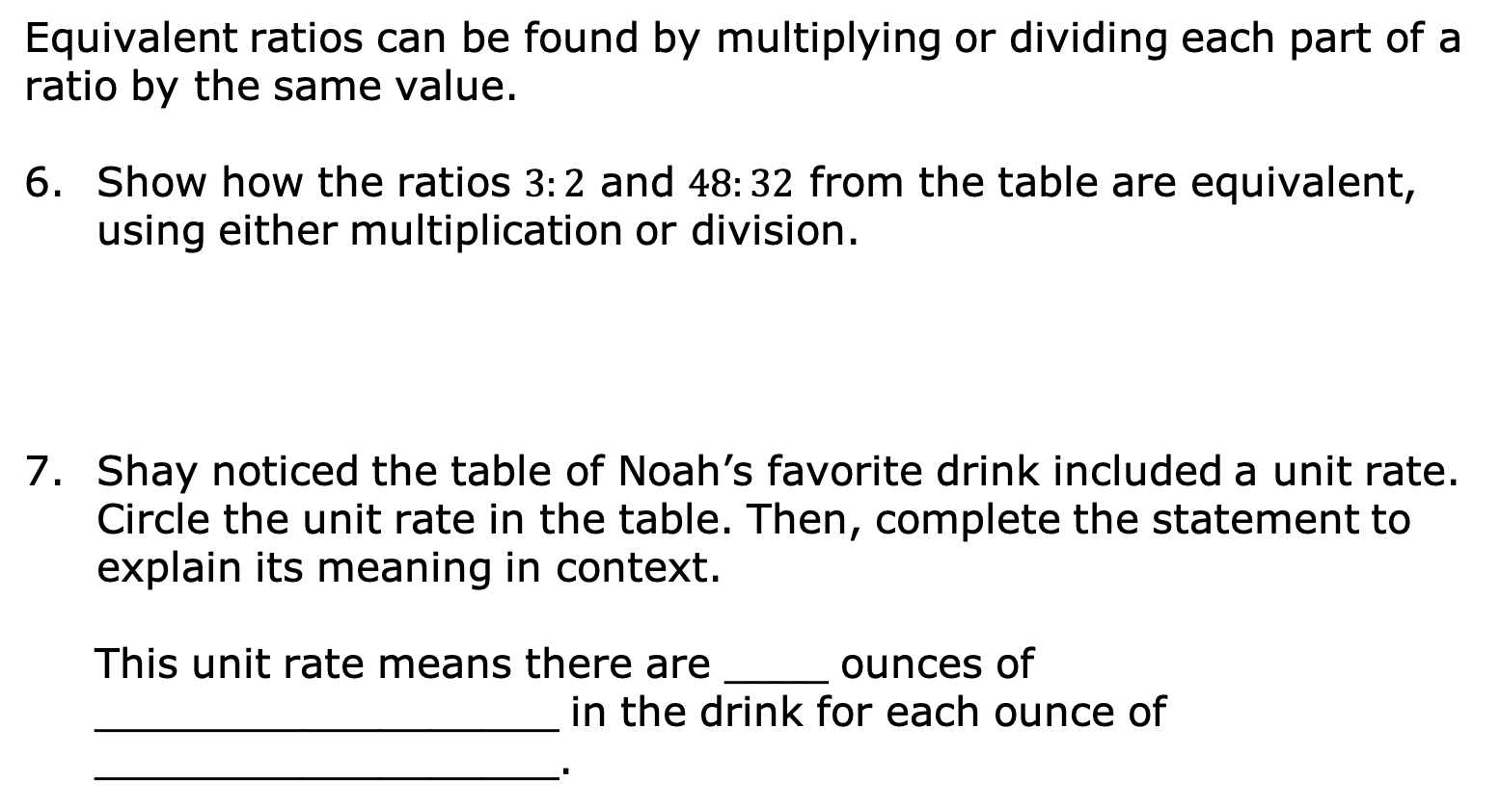
Equivalent ratios can be found by multiplying or dividing each part of a ratio by the same value.
Show how the ratios $3:2$ and $48:32$ from the table are equivalent, using either multiplication or division.
Shay noticed the table of Noah’s favorite drink included a unit rate. Circle the unit rate in the table. Then, complete the statement to explain its meaning in context.
This unit rate means there are ____ ounces of __________________ in the drink for each ounce of __________________.
volume 1, pg. 195

Slide 14

Collaboration
volume 1, pg. 195

Slide 15

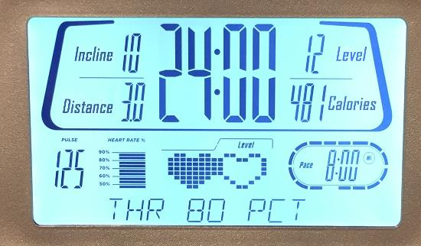
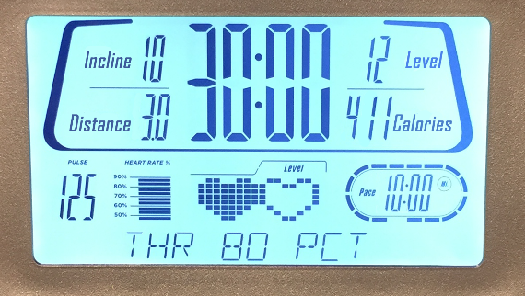
5.5.3 Collaboration: Considering Ratios and Rates in the Context of Speed
Mai and Jada each ran on a treadmill. The treadmill display shows the distance, in miles, each person ran and the amount of time it took them, in minutes and seconds.
Mai’s Treadmill Display | Jada’s Treadmill Display
volume 1, pg. 195

Slide 16
Discuss with your partner the similarities and differences between Mai’s and Jada’s workouts. Write them in the table below.
Similarities | Differences
Express each person’s workout as a ratio of distance to time, including units.
 | Ratio of Distance to Time
Mai’s Workout
Jada’s Workout
volume 1, pg. 195

Slide 17
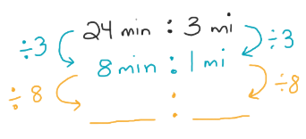
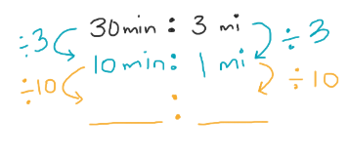
Each person ran at a constant rate by setting the speed on their treadmill. Discuss with your partner who ran at a faster rate using the ratios.
Eli thought it would be helpful to rewrite the ratios as unit rates when deciding who ran faster. His incomplete work is shown. Work with your partner to complete his work.
Mai’s Workout | Jada’s Workout
volume 1, pg. 196

Slide 18
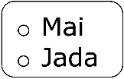
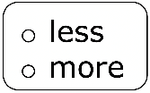
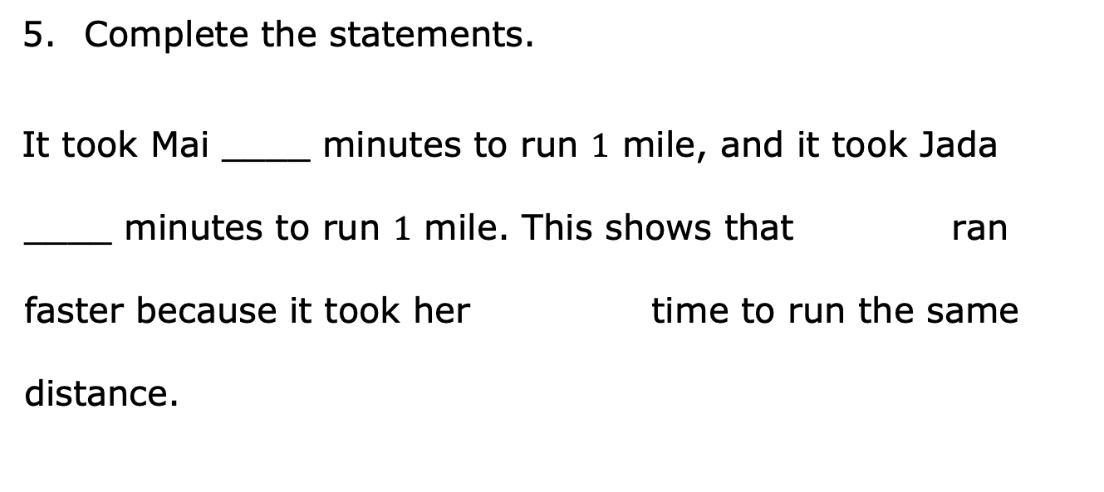
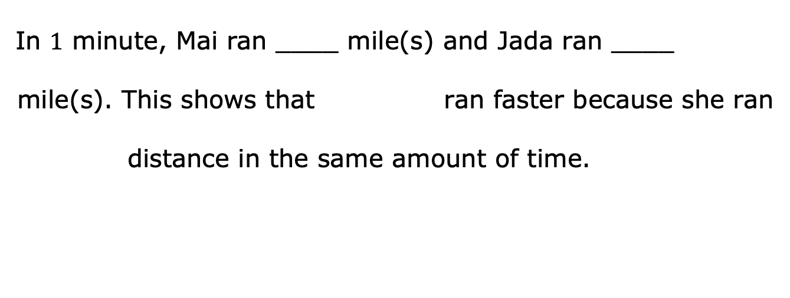
Complete the statements.
It took Mai ____ minutes to run $1$ mile, and it took Jada ____ minutes to run $1$ mile. This shows that ran faster because it took her time to run the same distance.
In $1$ minute, Mai ran ____ mile(s) and Jada ran ____ mile(s). This shows that ran faster because she ran
distance in the same amount of time.
volume 1, pg. 196

Slide 19

Try It
volume 1, pg. 196

Slide 20
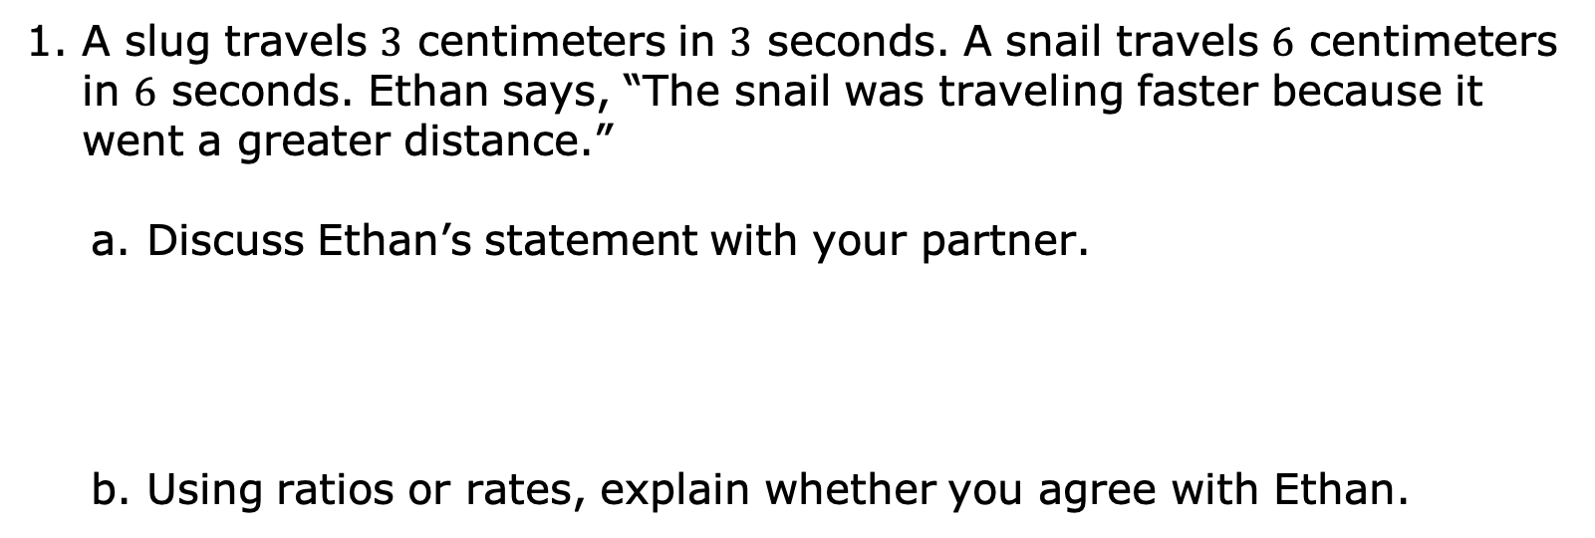
5.5.4 Try It: Rates and Ratios in Context of Speed
A slug travels $3$ centimeters in $3$ seconds. A snail travels $6$ centimeters in $6$ seconds. Ethan says, “The snail was traveling faster because it went a greater distance.”
Discuss Ethan’s statement with your partner.
Using ratios or rates, explain whether you agree with Ethan.
volume 1, pg. 196

Slide 21

Your Turn
volume 1, pg. 197

Slide 22








5.5.5 Your Turn!
Nadia is driving at a constant speed on a long stretch of highway on a long drive from Melbourne, Florida, to Atlanta, Georgia. Her distance traveled over time is shown on the double number line.
$$0$$
$$1$$
$$2$$
$$3$$
time (hours)
distance (kilometers)
$$0$$
$$70$$
$$140$$
$$210$$
How far did Nadia travel at this speed for $5$ hours? Explain or show your reasoning.
volume 1, pg. 197

Slide 23
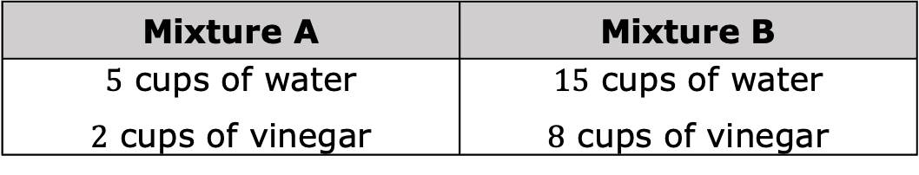
Two cleaning solutions were created to clean tile floors as shown.
Mixture A | Mixture B
$5$ cups of water $2$ cups of vinegar | $15$ cups of water $8$ cups of vinegar
Explain why the mixtures will not result in the same cleaning solution.
Explain which solution will have a stronger smell of vinegar.
volume 1, pg. 197

Slide 24

Wrap-Up
volume 1, pg. 197

Slide 25
5.5.6 Wrap-Up: Growth Mindset
Complete each statement.
Today I am still unsure about …
To fill this gap, I intend to …
volume 1, pg. 197

